Slide 1
INT222 - Internet Fundamentals
Week 6: More on CSS

Slide 2
Agenda
CSS text, font
Box model
CSS margin, border, padding, shorthand
CSS3 shadow effects

Slide 3
CSS Selector Review
css-group-tags.html

Slide 4
Formatting Text: font-family Properties
A font family or a font face is the typeface that will be applied by a web browser to some text.
The font family can use a specific named font, but the actual appearance will depend on the browser and the fonts installed on the system.
e.g., a default installation of I.E. always displays serif and Times as Times New Roman, and sans-serif and Helvetica as Arial.
A font-family (or face in HTML) consists of a set of related fonts, grouped as font families
4

Slide 5
Formatting Text: font-family
<!-- font.html -->
<!DOCTYPE html>
<html lang="EN">
<head>
<title> FONT </title>
<meta charset="UTF-8">
<style type="text/css">
p.serif {font-family: Times New Roman, Times, serif;}
p.sansserif {font-family: Arial, Helvetica, sans-serif;}
/* if Arial is not available, choose Helvetica, … */
p {background-color: grey;}
</style>
</head>
<body>
<h1> CSS font-family </h1>
<p class="serif"> This is a paragraph, shown in the
Times New Roman font. </p>
<p class="sansserif"> this is a paragraph, shown in the
Arial font. </p>
</body>
</html>
font.html
5

Slide 6
Formatting Text: font-family
6
The web browser will only be able to apply a font if it is available on the system on which it operates, which is not always the case.
So, list in preferential order font families to use when rendering text.
The font list is separated by commas.
To avoid unexpected results, the last font family on the font list should be one of the five generic families which are by default always available in HTML and CSS.

Slide 7
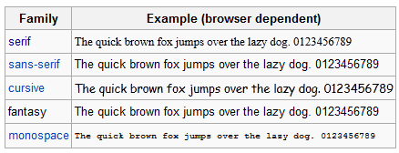
Generic Font Family
7

Slide 8
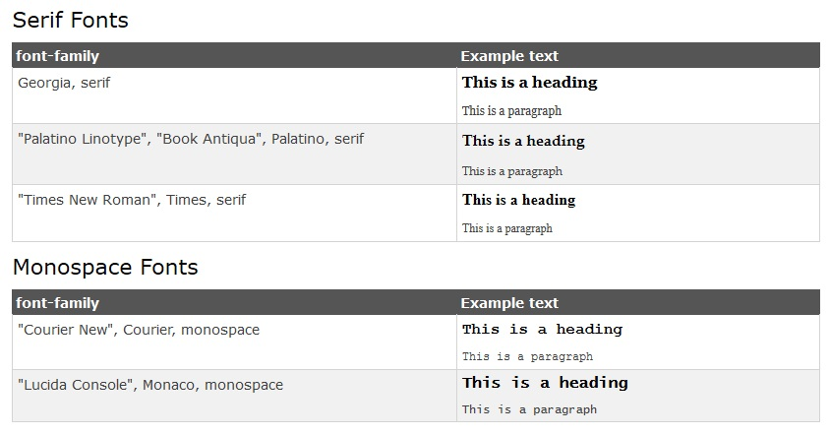
CSS Web Safe Font Combinations
Examples

Slide 9
Formatting Text: font-size
Font size for different elements
h1 { font-size:250%; } –size relative to regular size (scales well) p { font-size: 20pt; } –actual size in points,
div { font-size:20px; } –actual size in pixels,
a { font-size: smaller; } – smaller than regular size, default medium,
h1 { font-size: 1.5em; } – size relative to regular size (scales well)
9

Slide 10
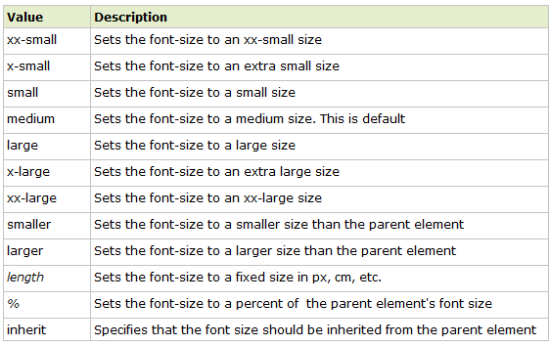
Font-size: Property values
10

Slide 11
Formatting Text: other text properties
{ font-weight: bold; } or “lighter”, “normal”, “bolder”
{ font-weight:700 ; } or 100, 200, 300, 400(normal), 500,600, 700 (bold), 800, 900
{ font-style: italic; } or “normal”, “oblique”
{ text-align: center; } or “left” (normal), “right”, “justify”
{ text-indent: 4em; } first-line indent, can use %, pt, px
{ text-indent: -4em; } hanging indent
11

Slide 12
Formatting Text other text properties
{ text-decoration: underline; } or “overline”, “line-through”, “blink”, “none”
{ text-transform: capitalize; } or “uppercase”, “lowercase”, “none”
{ font-variant: small-caps; } or “normal”
Shorthand:
h2 {font: italic small-caps bolder "Lucida","Arial"; text-decoration:underline; text-align:right; color:red; background-color:silver;}
font-2.html, text.html
12

Slide 13
CSS3 Text Effect
Text shadow:
Specify horizontal shadow, the vertical shadow, the blur distance, and the color of the shadow.
h1 { text-shadow: 5px 5px 5px red; }
text_css3.html
13

Slide 14
CSS3 Text Effect
CSS3 word wrapping
If a word is too long to fit within an area, it expands outside
In Css3, the word-wrap property allows to force the text to wrap
Even if it means splitting it in the middle of a word.
E.g.
P.wrap { word-wrap: break-word; }
text_css3.html
14

Slide 15
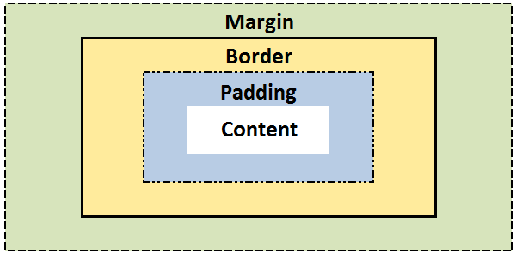
The CSS Box model
All elements can be considered to be box.
The box model is the specification that defines how a box and its attributes relate to each other.
A box is made up of four distinct parts, from the outside one to the inside one:
margin, border, padding, and content.

Slide 16
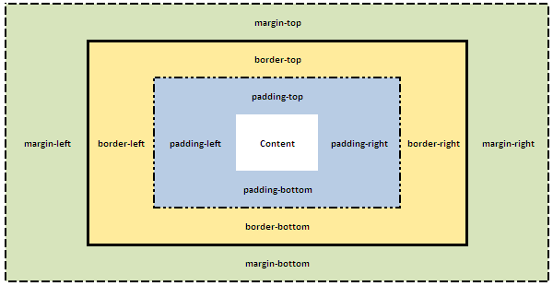
The CSS Box model
box-model.html
Notes:
Css for html and body as selectors.
-> use body for page

Slide 17
CSS Properties for Box Model
CSS margin
CSS border
CSS padding
CSS Shortcut

Slide 18
CSS margin
CSS Margins define the white space around an HTML element's border. See the "Box model".
box-margin.html
margin | Applies to all sides
margin: 6px; /* this is a shortcut */ | Applies a margin to all sides of an element
margin-top | Applies a margin to the top of an element
margin-right | Applies a margin to the right of an element
margin-bottom | Applies a margin to the bottom of an element
margin-left | Applies a margin to the left of an element
Notes:
{Margin: auto;} can be used to centerlize the box.
To centerlize text such heading, use {text-align: center;}

Slide 19

Margin Collapsing
Top and bottom margins of blocks are sometimes combined (collapsed) into a single margin whose size is the largest of the margins combined into it, a behavior known as margin collapsing.
e.g.
h1 { margin: 0 0 25px 0; background: #cfc; }
p { margin: 20px 0 0 0; background: #cf9; }
http://www.sitepoint.com/web-foundations/collapsing-margins/

Slide 20
CSS Shorthands for Box Model
CSS Shortcuts allow for a property to have a single or multiple values.
Shortcuts/shorthand order: CLOCKWISE:
top -> right-> bottom→ left

Slide 21
The margin Shorthand Property
To set all the margin properties in one declaration Examples:
margin:10px 5px 15px 20px;
top margin is 10px
right margin is 5px
bottom margin is 15px
left margin is 20px
margin:10px 5px 15px;
top margin is 10px
right and left margins are 5px
bottom margin is 15px
margin:10px 5px;
top and bottom margins are 10px
right and left margins are 5px
margin:10px;
all four margins are 10px

Slide 22
CSS border
The border property allows for setting the width, style and color and of the borders around an element.
The border style property value for the border must be stated, otherwise no border will show up.

Slide 23
CSS border
The border-width Property
The border-width can be set in pixels, ems, or one of the three pre-defined values: thin, medium, or thick.
border-width.html
border-width | Applies to all sides
border-width: 6px; border-style: solid; | Applies a solid border to all sides
border-top-width | Applies only to the top border
border-right-width | Applies only to the right border
border-bottom-width | Applies only to all bottom border
border-left-width | Applies only to the left border

Slide 24
The border-width Shorthand
border-short.html
Example | Description
border-width:6px; | adds a border - 6px to all four sides
border-width:6px 12px; | adds a border - 6px to top and bottom - 12px to the right and left
border-width:6px 12px 10px; | adds a border - 6px to the top, 12px to the right, 10px to bottom and 12px to the left
border:6px solid red; | Width, style, color!

Slide 25
CSS border
The border-style property
can have from one to four values from the list of
dotted , dashed , solid , double , groove , ridge , inset , outset , hidden.
border-style.html
border-style | Applies to
border-style:solid; /* default width of 3px */ | Applies a solid border to all sides
border-top-style | Applies the style only to the top border
border-right-style | Applies the style only to the right border
border-bottom-style | Applies the style only to all bottom border
border-left-style | Applies the style only to the left border

Slide 26
CSS border
The border-color property
border-color.html
border-color | Applies to
border-color:#ff0000; border-style: solid; | Applies a solid border to all sides
border-top-color | Applies only to the top border
border-right-color | Applies only to the right border
border-bottom-color | Applies only to all bottom border
border-left-color | Applies only to the left border

Slide 27
The Border Shorthand Property
shorthand property: specify all the individual border properties in one property.
The border property is a shorthand for the following individual border properties:
border-width
border-style (required)
border-color
border: 5px solid red;
border-short.html

Slide 28
CSS padding
CSS Padding property defines the white space around the inside of an HTML element's border. See the "Box model".
box-padding.html
padding | Applies to all sides
padding:6px; /* this a short cut */ | Applies padding to all sides of an element
padding-top | Applies padding to the top of an element
padding-right | Applies padding to the right of an element
padding-bottom | Applies padding to the bottom of an element
padding-left | Applies padding to the left of an element

Slide 29
CSS3 Rounded Corners
Property: border-radius
Example:
div { border: 2px solid #a1a1a1;
padding: 10px 40px;
background: grey;
width: 300px;
border-radius:250px;
/* border-radius:10%; */
-moz-border-radius:25px; /* Firefox 3.6 and earlier */
}
boxShadow_roundedCorners.html

Slide 30
CSS3 Rounded Corners
border-radius:2em; is equivalent to: border-top-left-radius: 2em; border-top-right-radius: 2em; border-bottom-right-radius: 2em; border-bottom-left-radius:2 em

Slide 31
CSS3 Box Shadow
CSS3 provides not only text-shadow but also box-shadow effects.
Property: box-shadow
box-shadow value: h-shadow v-shadow blur spread color inset;
boxShadow_roundedCorners.html

Slide 32
CSS3 Box Shadow
Value | Description
h-shadow | Required. The position of the horizontal shadow. Negative values are allowed
v-shadow | Required. The position of the vertical shadow. Negative values are allowed
blur | Optional. The blur distance
spread | Optional. The size of shadow
color | Optional. The color of the shadow. The default value is black. Look at CSS Color Values for a complete list of possible color values.
inset | Optional. Changes the shadow from an outer shadow (outset) to an inner shadow
css-ball.html
http://www.cssmatic.com/box-shadow

Slide 33
Resourceful Links
CSS Reference
http://reference.sitepoint.com/css
Box model - CSS | MDN
https://developer.mozilla.org/en-US/docs/Web/CSS/box_model
CSS Properties
http://reference.sitepoint.com/css/propertyref
CSS Selectors
http://reference.sitepoint.com/css/selectorref

Slide 34
Thank You!

